Slide 1
DS801_맥가이버
Jeongho Kim 20243182
Haejun Kim 20243226
Dimas Ahmad 20244071
Minkyung Choi 20234447
Uhjin Hur 20225600
Notes:
Hi, we are Team Macgyver

Slide 2
Contents
01. Project Overview and Overall Process
02. Task 1: Validation Set
03. Task 2: Training Set
04. Result
05. Conclusion
Notes:
Here's our content:
First, an explanation of our overall process based on the project.
Next, Details on how we created our validation and training sets.
Last, Presentation of our results and conclusion.

Slide 3
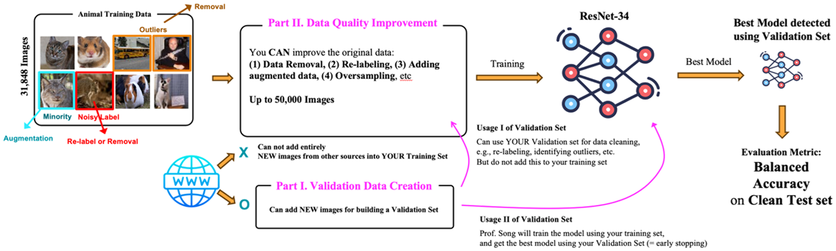
01
Project Overview and
Overall Process
Notes:
OK, Let’s get into the first part

Slide 4
Project Overview and Overall Process
Collect validation set
Validation creation with checking its quality
1
Handle the challenges
Handle outliers, noisy labels, and class imbalance present in the given training set
Repeat until the accuracy is optimized
2
Check the accuracy
Check whether the adjustment of the training dataset was meaningful or not
3
Notes:
We set three steps for the project:
1 was to Collect the validation set.
2 was to Clean the training set by handling the challenges.
3 was to Continuously check Resnet performance using the validation set.
I will provide more details in the following sections.

Slide 5
02
Task 1: Validation Set
Collect validation set
Validation creation with checking its quality
1
Handle the challenges
Handle outliers, noisy labels, and class imbalance present in the given training set
Repeat until the accuracy is optimized
2
Check the accuracy
Check whether the adjustment of the training dataset was meaningful or not
3

Slide 6

Rationale and Approach
Accurate Evaluation: A high-quality validation set allows us to accurately evaluate the performance of our enhanced training dataset
Generalization Assessment: If the validation set is also noisy or of low quality, it becomes difficult to determine whether the model is performing well or just overfitting to the noise
Collect validation set
a. Initial Approach: Google Crawling
1
Handle the challenges
Noises
Repeat until the accuracy is optimized
Check the accuracy
Google crawling:
query = "hamster"
url = f"https://www.google.com/search?q={query}&source=lnms&tbm=isch"
2
3
Time-consuming
Notes:
For the validation set, our primary goal was to ensure high quality.
This allows us to accurately evaluate the performance of our enhanced training set and improve generalization.
If the validation set is noisy, we can't confidently determine if our model is performing well or just overfitting to the noise.
Initially, we tried Google crawling, but it was time-consuming and produced many noisy results, like a hamster holding a machine gun.

Slide 7
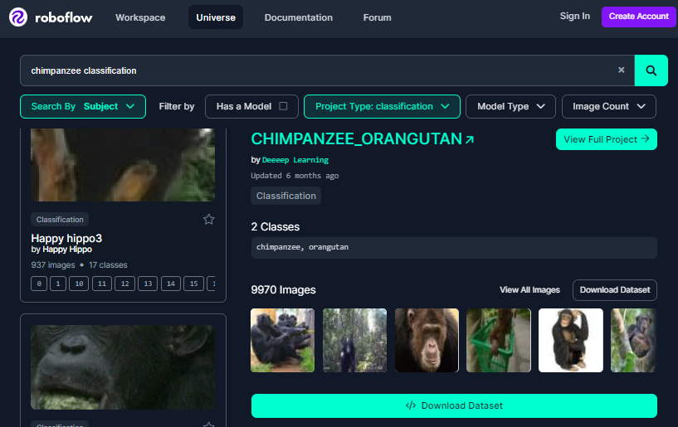
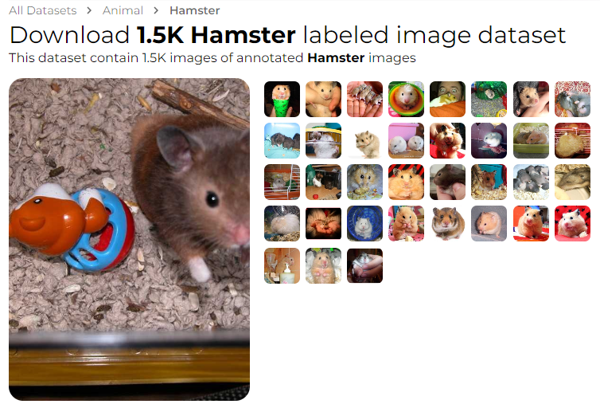
Method: Utilizing Open-source Image Databases
Quality and accuracy: Open-source databases (Roboflow, Image.CV) provide high-quality labeled images with strict curation, ensuring that the images are accurately categorized
Efficiency: More efficient than manual crawling and verification
Scalability: Sufficient and large in volume
Collect validation set
a. Initial Approach: Google Crawling b. Open-source Image Databases
1
Handle the challenges
Repeat until the accuracy is optimized
Check the accuracy
2
3
Roboflow
Image.CV
Notes:
So we downloaded images from two open-source databases, where we could find high-quality labeled images more efficiently.

Slide 8
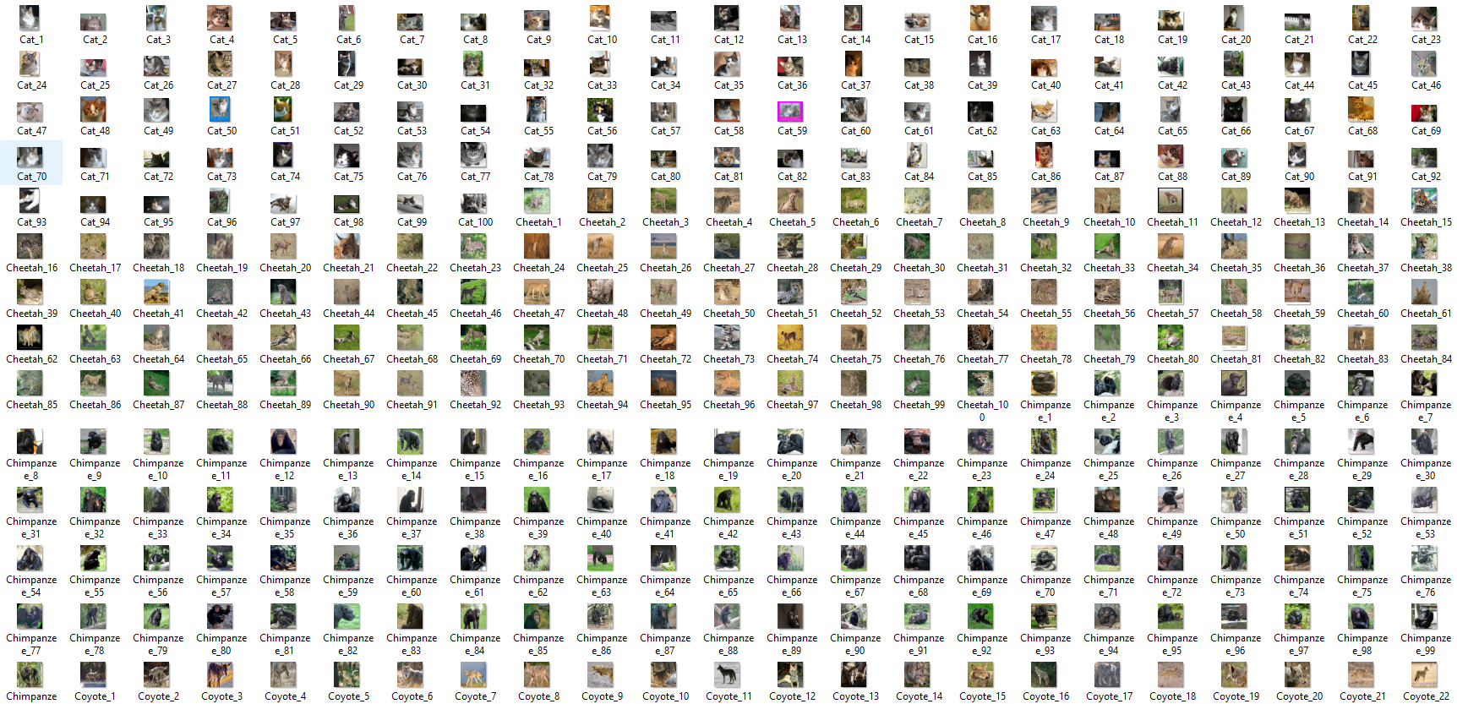
Execution
1
Data Collection
Collect validation set
a. Initial Approach: Google Crawling b. Open-source Image Databases c. Data Collection
1
Handle the challenges
Repeat until the accuracy is optimized
Check the accuracy
2
Download the images for each class from Roboflow, Image.CV 13,720 images However, since noisy images might still exist, it was necessary to verify the quality of the dataset
3
Notes:
In this way, we were able to collect around 14 thousand images.
However, since noisy images might still exist, it was necessary to verify the quality of the dataset.

Slide 9
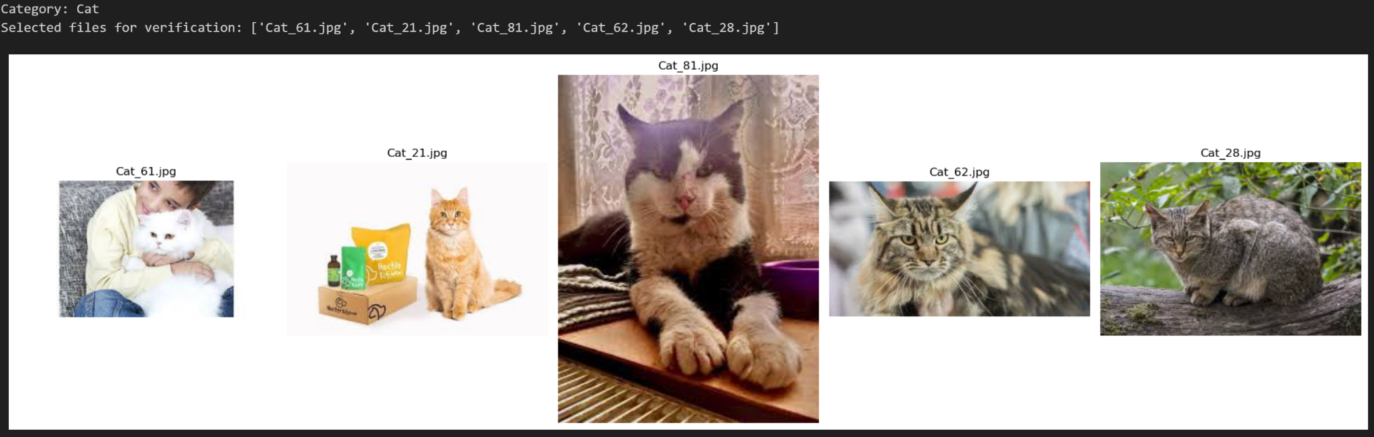
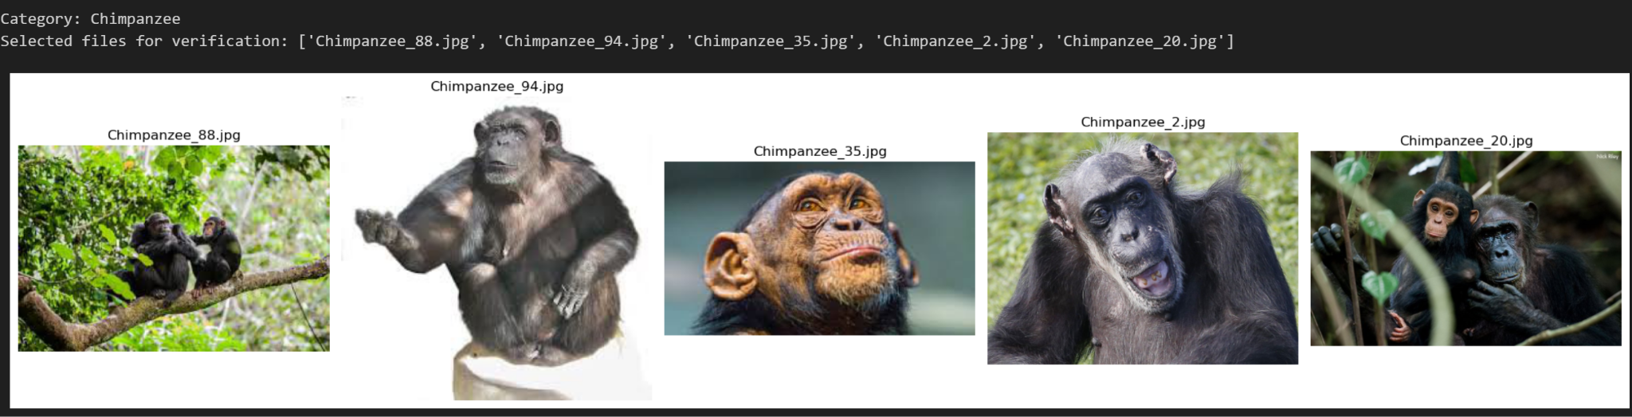
Execution
Verification (1) - Random Sampling
Data collection
2
Collect validation set
a. Initial Approach: Google Crawling b. Open-source Image Databases c. Data Collection d. Verification (1) - Random Sampling
1
Handle the challenges
Repeat until the accuracy is optimized
Check the accuracy
2
To check with bare eyes on whether the images fit their corresponding classes or not But just visually checking the dataset is not sufficient for accurate verification
3
Notes:
Our first verification step was to randomly load the datasets by animal classes and visually check if the images matched their labels. But just visually checking the dataset is not sufficient for accurate verification, as human interpretation and model interpretation of images differ significantly.

Slide 10
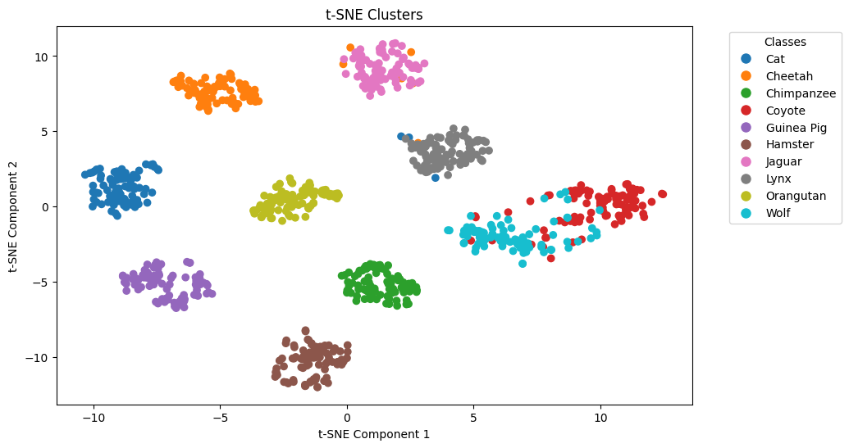
Execution
Verification (2) - Clustering
Data collection
2
Collect validation set
a. Initial Approach: Google Crawling b. Open-source Image Databases c. Data Collection d. Verification (1) - Random Sampling e. Verification (2) - Clustering
1
Handle the challenges
Repeat until the accuracy is optimized
Check the accuracy
2
K-means clustering with the features extracted from the EfficientNet and then excluding the images with low silhouette scores 100 images/class ⇒ 1,000 images in total
3
Notes:
Therefore, we used the efficientnet-b7 model to extract image features. We then clustered them using K-means.

Slide 11
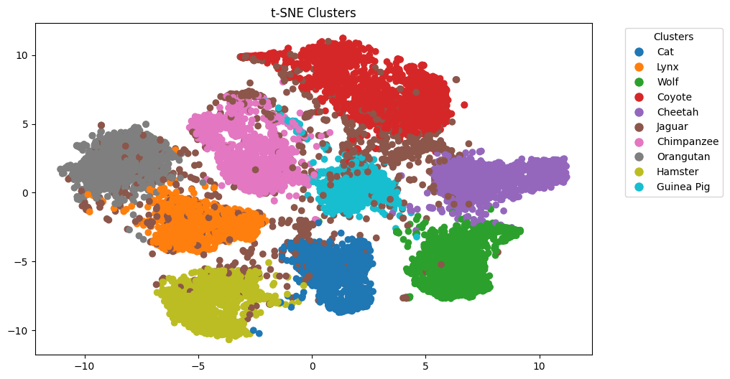
Execution
Collect validation set
a. Initial Approach: Google Crawling b. Open-source Image Databases c. Data Collection d. Verification (1) - Random Sampling e. Verification (2) - Clustering
2
Verification (2) - Clustering
1
Feature extraction (EfficientNet) → Clustering (KMeans) → Visualization (t-SNE) The average silhouette score: 0.19 ( * silhouette scores ∊ [-1, 1] )
Handle the challenges
Repeat until the accuracy is optimized
Check the accuracy
2
* Silhouette scores ∊ [-1, 1] a measure of how similar an object is to its own cluster compared to other clusters
1 ⇒ indicates that the object is well matched to its own cluster and poorly matched to neighboring clusters
0 ⇒ indicates that the object is on or very close to the decision boundary between two neighboring clusters
-1 ⇒ indicates that the object might have been assigned to the wrong cluster
3
Keep top 100 silhouette score images for each class 100 images/class ⇒ 1,000 images in total The average silhouette score: 0.41
Notes:
The top right image shows the TSNE plot from our K-means clustering. While there are distinct class clusters, many points are scattered.
We used the silhouette score to discard images with low scores, making the clusters more robust. This ensured the remaining images had distinct features separating them from other classes.
(since our goal is also to enhance the quality of the train data, high quality validation set with distinct features by classes provide the benefit of accurately assessing improvements, ensuring robustness, providing consistent benchmarks)
As a result, we obtained 100 images per class, totaling 1,000 images for the dataset.

Slide 12
Summary of Task 1
Image collection
from Roboflow, Image.CV
Collect validation set
a. Initial Approach: Google Crawling b. Open-source Image Databases c. Data Collection d. Verification (1) - Random Sampling e. Verification (2) - Clustering
1
Validation set quality verification
Handle the challenges
Repeat until the accuracy is optimized
Check the accuracy
2
Random sampling checking
Clustering
with silhouette scores
3
Notes:
Here is the summary of Task 1:
Firstly. Collected images from two databases.
After that, we verified data quality through random sampling and clustering with silhouette scores.

Slide 13
03
Task 2: Training
Set
Collect validation set
Validation creation with checking its quality
1
Handle the challenges
Handle outliers, noisy labels, and class imbalance present in the given training set
Repeat until the accuracy is optimized
2
Check the accuracy
Check whether the adjustment of the training dataset was meaningful or not
3
Notes:
Now, let’s move onto the 2nd task: training set.

Slide 14
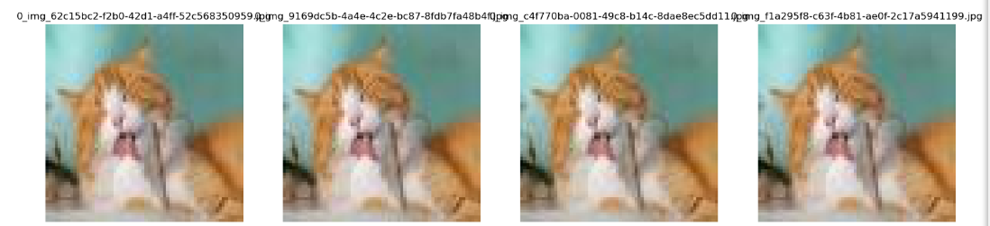
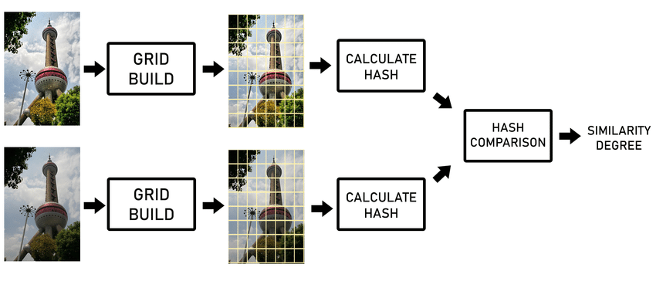
Handling the Challenges with Removing Duplicate Images
The same “cat” images with different file names
Remove them using “Perceptual Hashing”
Collect validation set
Handle the challenges
1
a. Removing Duplicate Images
Repeat until the accuracy is optimized
2
The same “cat” images with different file names
Check the accuracy
3
Perceptual Hashing
Notes:
First of all, we found duplicate images with different file names in the training set.
We removed them using perceptual hashing, which calculates similarity by comparing hashes.

Slide 15
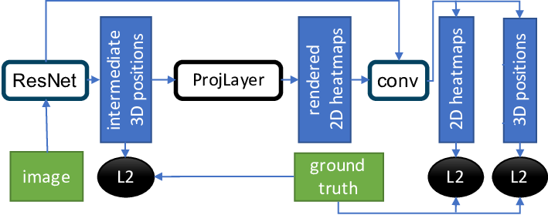
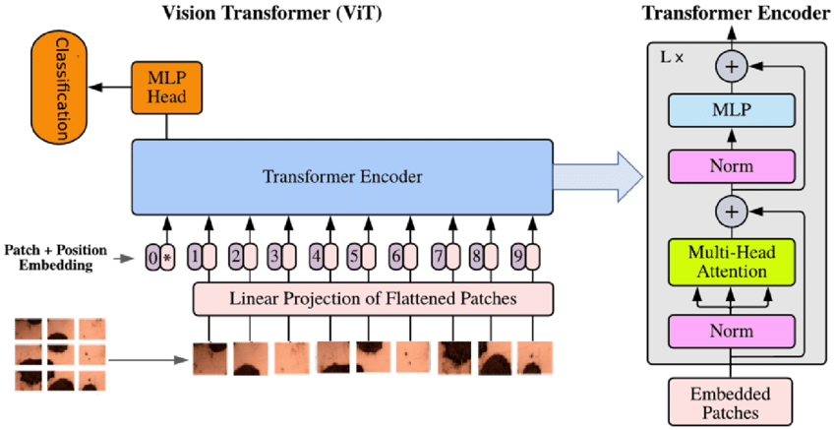
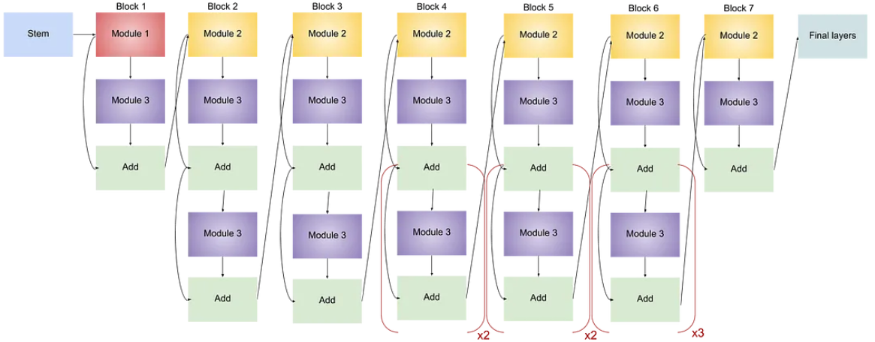
Handling the Challenges with Pre-trained Models — Motivation
Use pre-trained models from Pytorch “Regnet”, “Vit”, “EfficientNet” pre-trained with Imagenet 1K
Collect validation set
Regnet
Handle the challenges
1
a. Removing Duplicate Images b. 3 Pre-trained Models Selection
Repeat until the accuracy is optimized
2
Vit
Check the accuracy
3
EfficientNet
Notes:
To detect outliers and noisy labels, we used 3 different pre-trained models from Pytorch.
Like different people offering different perspectives, we believed comparing the predictions of three models with different architectures would yield more accurate results

Slide 16
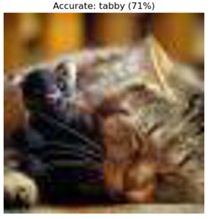
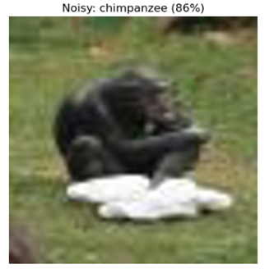
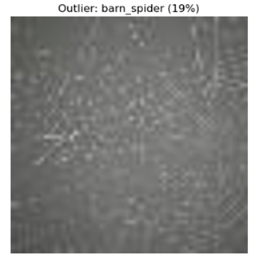
Handling the Challenges with Pre-trained Models — Label Comparison
For each model: Prof’s label vs. Model’s prediction “Accurate” ⇒ Prof’s label == Model's prediction “Noisy” ⇒ Prof’s label ≠ Model's prediction, BUT in the 10 labels “Outlier” ⇒ Prof’s label ≠ Model's prediction, NOT in the 10 labels
Collect validation set
0: Cat 1: Lynx 2: Wolf 3: Coyote 4: Cheetah 5: Jaguar 6: Chimpanzee 7: Orangutan 8: Hamster 9: Guinea Pig Spider web ???
Handle the challenges
Prof’s label | Model’s prediction | Comparison Mark
Cat | Cat | Accurate
Cat | Chimpanzee | Noisy
Cat | Spider web | Outlier
1
a. Removing Duplicate Images b. 3 Pre-trained Models Selection c. Prof’s label vs. Model’s prediction
Repeat until the accuracy is optimized
2
Check the accuracy
3
Three images from the given “Cat” category, but with different predictions of the model
Notes:
We had each model predict the image labels of the training set and compared these predictions with the original labels provided by the professor. The categorization was as follows:
If the professor's label matched the model's prediction, we considered the image accurately labeled.
If the professor's label differed from the model's prediction, but the prediction was still within the 10 categories of the training set, we marked it as noisy.
If the professor's label differed and the model's prediction was not within the 10 categories, we marked it as an outlier.
For example, these three images were all labeled as “Cat” by the professor, but one model predicted those labels as “cat”, “chimpanzee” and “spider web”, respectively.
For the first case, as they were the same, we marked as “accurate”;
The 2nd case was marked as “noisy”, since “chimpanzee” was different from “cat” but still within the 10 categories;
The third case was marked as an “outlier” because “spider web” is not within the 10 categories.
After three iterations of this label comparison process for all three models, (next slide)...
And we made each model predict the image labels of the training set;
Then, we compared those predictions with the original labels given by the professor.
If the prof’s label and the model’s prediction were the same, we regarded those images as the accurately-labeled ones.
If the prof’s label and the model’s prediction were different, BUT the model’s prediction was still in the 10 categories used in the given training set, we regarded those as noisy ones.
If the prof’s label and the model’s prediction were different, and even worse, the model’s prediction was NOT in these categories, we regarded those as outliers.

Slide 17
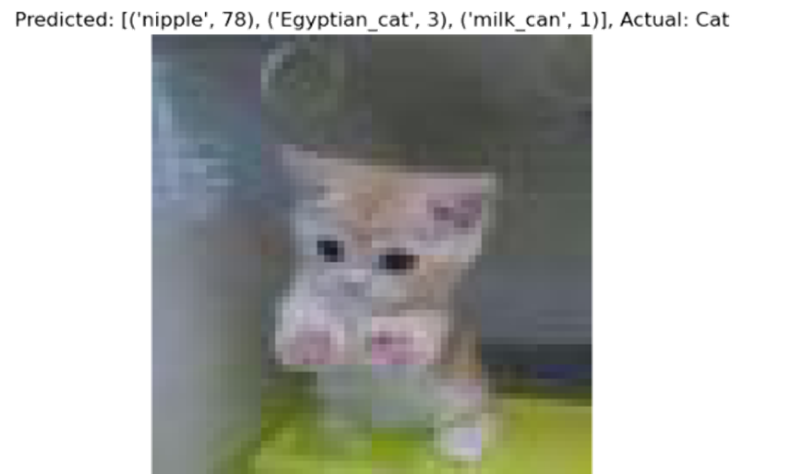
Handling the Challenges with Pre-trained Models — Hard Voting
Regnet
Vit
EfficientNet
Accurate
Noisy
Outlier
Accurate
Noisy
Outlier
Accurate
Noisy
Outlier
Collect validation set
All different: 6 cases (400 images) The image itself was considered to be unclear ⇒ Removed all of these cases
≥ 2 models’ marks were “Accurate”: 7 cases (11,425 images) Kept the Prof’s label
≥ 2 models’ marks were “Noisy”: 7 cases (8,269 images) If the majority had the same predictions ⇒ Kept the majority's label If each had a different prediction ⇒ Vit > Regnet > EfficientNet
≥ 2 models’ marks were “Outlier”: 7 cases (11,458 images) Checked the 2nd prediction of each model - Prof’s label == 2nd Model's prediction ⇒ “Accurate” (1,122 images) - Prof’s label ≠ 2nd Model's prediction, BUT in the 10 labels ⇒ “Noisy” (1,600 images) - Prof’s label ≠ 2nd Model's prediction, NOT in the 10 labels ⇒ real “Outlier” (removed)
Handle the challenges
(A, N, O) * 6
1
(A, A, O) * 3 (A, A, N) * 3 (A, A, A) * 1
a. Removing Duplicate Images b. 3 Pre-trained Models Selection c. Prof’s label vs. Model’s prediction d. Hard Voting
Repeat until the accuracy is optimized
2
(N, N, O) * 3 (N, N, A) * 3 (N, N, N) * 1
Check the accuracy
(O, O, A) * 3 (O, O, N) * 3 (O, O, O) * 1
3
Top 3 labels predicted by the model
Notes:
We used “hard voting” for all possible 27 cases.
For the same image, if the label comparison marks were all different (e.g., one model marked it as “Accurate,” another as “Noisy,” and the other as “Outlier”), we regarded the image as unclear and removed it.
Similarly, for the same image:
If more than 2 models marked it as “Accurate,” we kept the original professor’s label.
If more than 2 models marked it as “Noisy,” and the majority had the same prediction, we kept the majority’s label. If each had a different prediction (e.g., the Vit model predicted “chimpanzee,” Regnet predicted “wolf,” and EfficientNet predicted “hamster” for the same cat image), we adopted the labels in the order of Vit > Regnet > EfficientNet, based on their performance.
If more than 2 models marked it as “Outlier,” we checked the second prediction of each model. In fact, each model was set to predict the top 3 labels. For instance, if a model first predicted “nipple” but correctly predicted "cat" on the second try, we re-marked it as “Accurate.” and performed another round of hard voting If images were marked as “Outlier” again, we removed them, considering them as real outliers.
시간 좀 남으면 (N, N, O)등 예시설명 추가하기(?)

Slide 18
Accuracy and Enhancement Checking with the Validation Set
Collect validation set
Handle the challenges
1
a. Removing Duplicate Images b. 3 Pre-trained Models Selection c. Prof’s label vs. Model’s prediction d. Hard Voting
Accuracy checking using the base code given by Prof. Song
Repeat until the accuracy is improved
Repeat until the accuracy is optimized
2
Check the accuracy
3
Notes:
Finally, we checked the validation accuracy using our own validation set.

Slide 19
Summary of Task 2
Removing Duplicate Images
Collect validation set
Handle the challenges
Hard Voting of 3 Pre-trained Models
1
a. Removing Duplicate Images b. 3 Pre-trained Models Selection c. Prof’s label vs. Model’s prediction d. Hard Voting
Repeat until the accuracy is optimized
2
Check the accuracy
Noise Re-labeling
Outlier Removal
3
Accuracy checking with the validation set
Notes:
Here’s the summary of Task 2,
We firstly removed the duplicate images with perceptual hashing,
And through hard-voting with 3 different pre-trained models, we performed noise re-labeling and outlier removal, followed by accuracy checking with the validation set

Slide 20
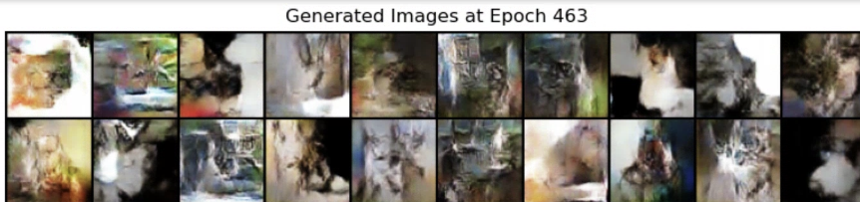
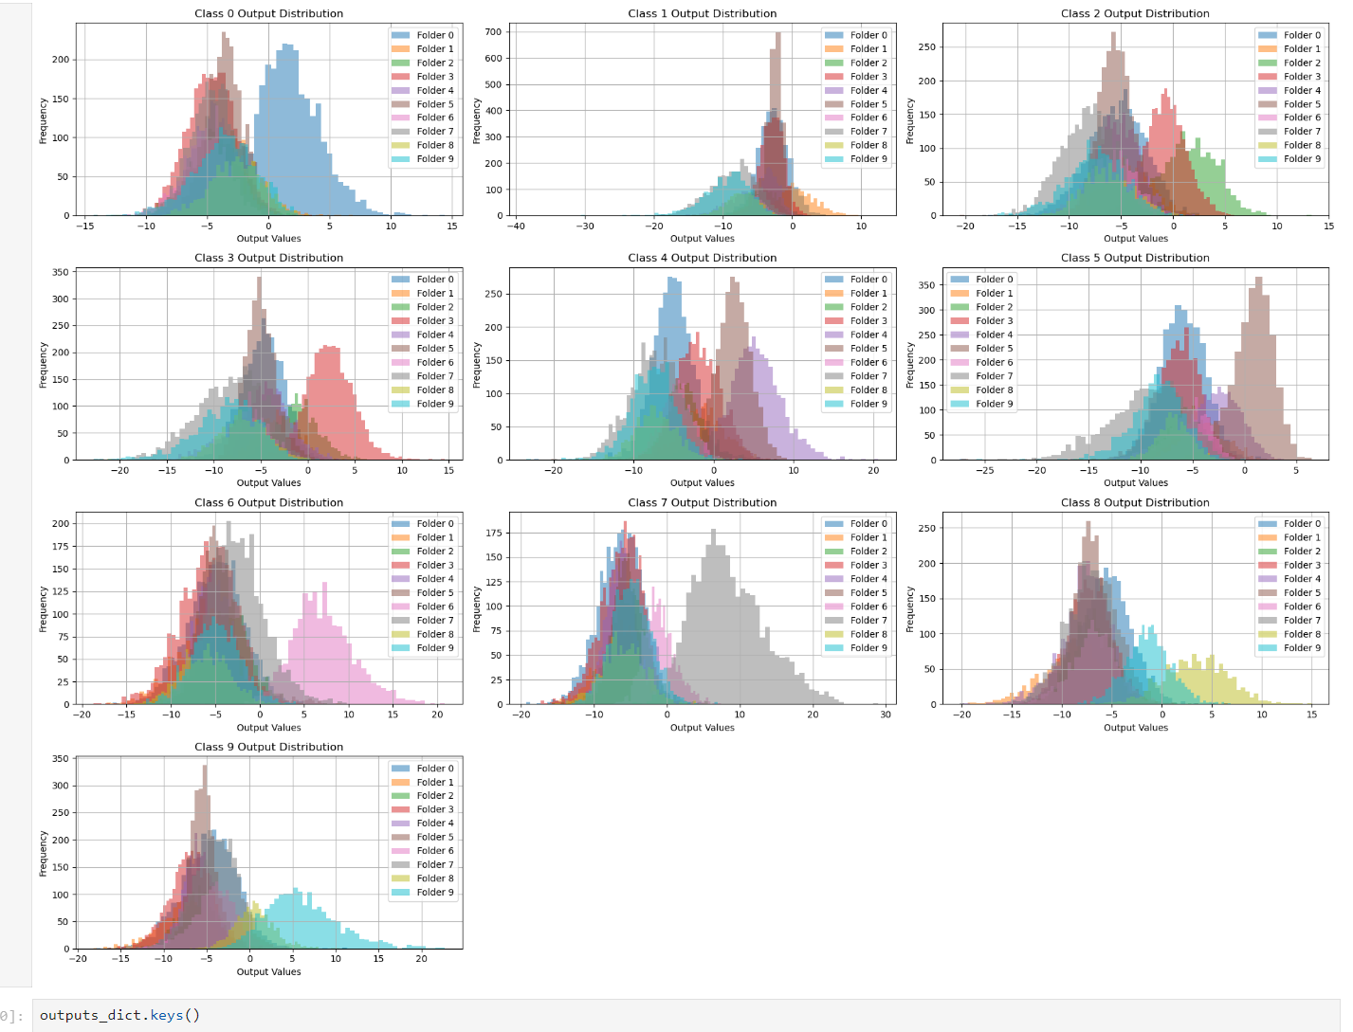
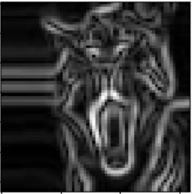
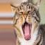
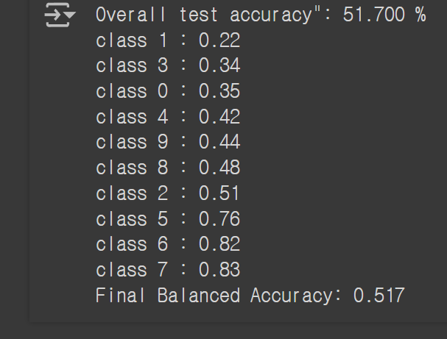
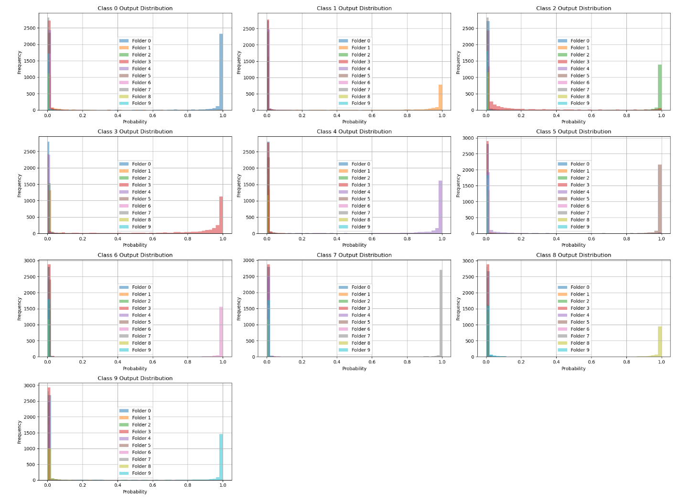
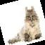
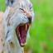
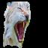
Many Other Trials…
Augmentation
Data cleaning
GAN to generate images
Fine-tuning
Sobel edge detection
Rotation, Flip
Background removal maskrcnn_resnet50
Notes:
Actually, besides hard-voting, we also tried so many things to improve the training set.
We used GAN, sobel edge detection, background removal to augment images;
We also fine-tuned a model to detect noises and outliers.

Slide 21
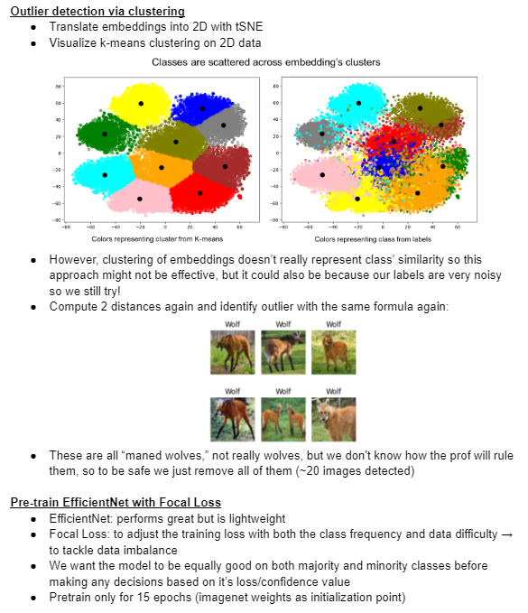
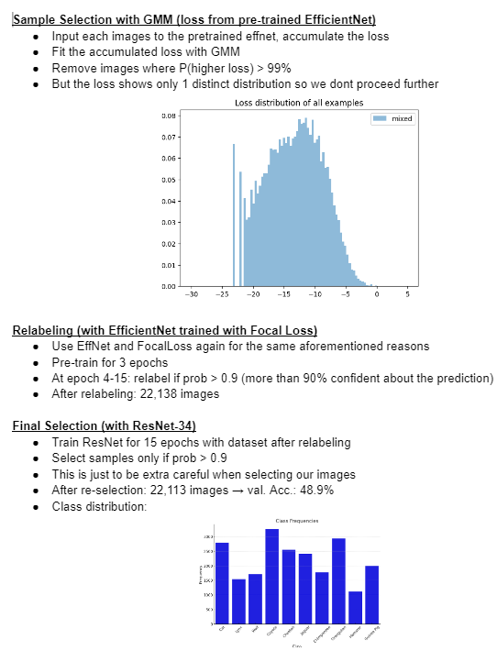
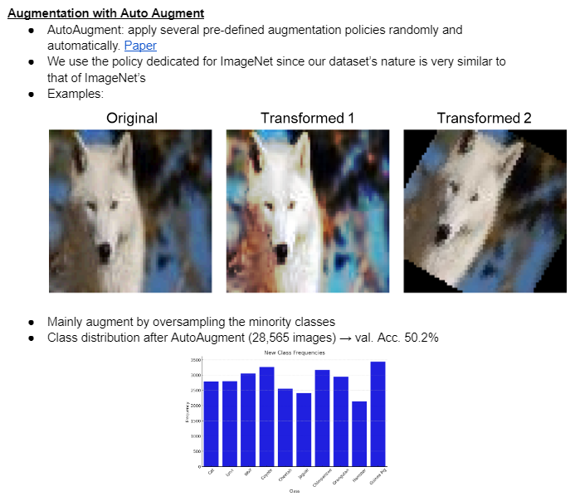
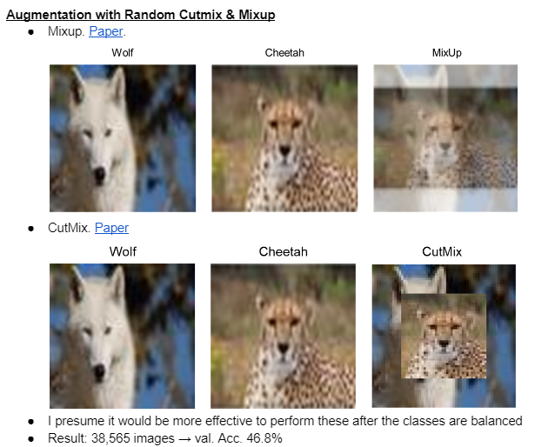
Many Other Trials…
Notes:
We also tried sample selection with GMM, CutMix and MixUp augmentation and so on..
However, the method using hard voting showed the best results in our case.

Slide 22
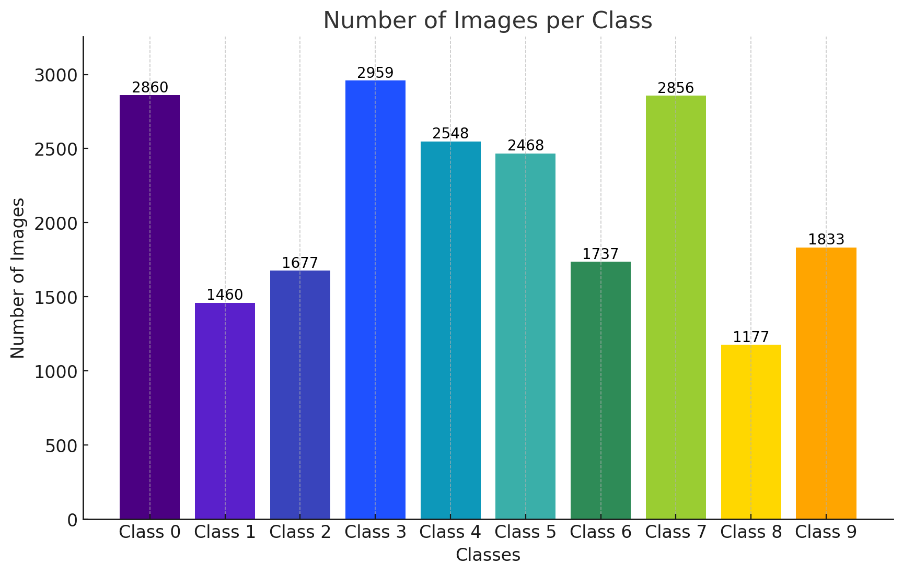
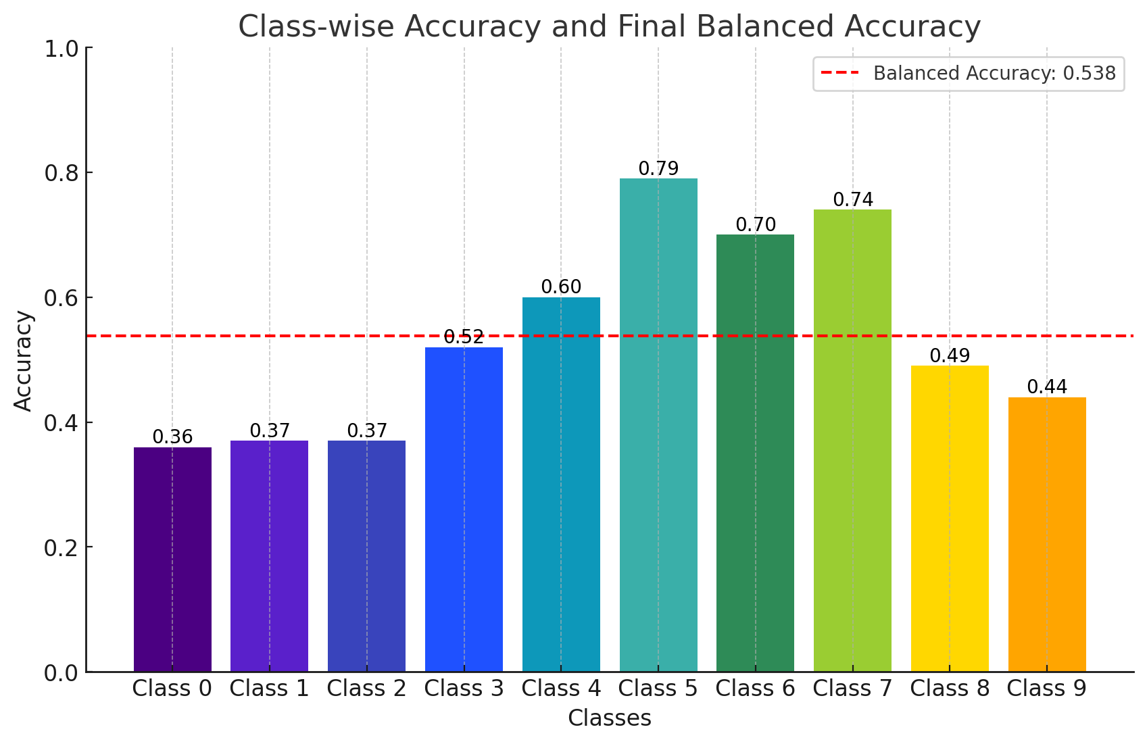
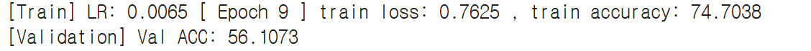
04
Result
21,575 images
Notes:
Here is the final version of our training dataset:
The top graph shows the number of images per class. We have a total of 21,575 images. The number of images varies across classes due to the removal of different numbers of outliers and noisy images.
The bottom one shows the accuracy across all classes. When we did early stopping, the balanced accuracy is around 56% due to the complexity of classifying certain classes. Similar animal classes such as cat/lynx, wolf/coyote, and hamster/guinea pig were particularly hard to classify.
You might wonder why we didn't augment the dataset to 50k images. Augmentation resulted in lower accuracy because we hadn't fully removed noisy/outlier labels. Augmenting these images further deteriorated the accuracy.
So this is the final version of the training dataset that we have constructed.
The graph on the top shows the number of images per class. We have a total of 21575 (need to check this number) images and as you can see, we have different number of images across all classes. We’ve identified different number of outliers and noisy images from each class. So, while removing them, it resulted in the difference of the number of images across the class.
The plot below shows the accuracy across all classes. Due to the complexity of classifying some classes, the balanced accuracy is around 56% (early stopping).
Similar animal classes such as cat/lynx, wolf/coyote, hamster/guinea pig were especially hard to classify correctly.
You might ask why we have stayed with the current number of images without augmenting them to 50k. This is because augmentation resulted in a lower accuracy. We believe that the reason behind this is because we haven’t fully erased the noisy/outlier/(confusing 이건 선택) labels. So, when we do the augmentation on the images, noisy/outlier images also get augmented and actually deteriorate the accuracy again.

Slide 23
05
Conclusion
Key Takeaways 1. Clustering and Validation: The use of KMeans clustering and t-SNE visualization helped verify the consistency and accuracy of our validation set. The silhouette score provided a quantitative measure to assess and enhance the clustering quality. 2. Pre-trained Model Selection: Using models trained on ImageNet allowed us to harness their feature extraction capabilities. This was instrumental in accurately classifying and cleaning the dataset, demonstrating the power of transfer learning. 3. Hard Voting for Data Cleaning: By employing three distinct pre-trained models (RegNet, ViT, EfficientNet) and using hard voting, we effectively filtered out noisy and outlier data points. This method proved to be the most impactful in improving validation accuracy.
Limitations 1. Silhouette Score Limitations: While the silhouette score helped improve our validation set, it is not a perfect measure. Some images with lower scores might still be valid, and the reliance on this metric may have led to the exclusion of potentially useful data. 2. Model Bias: The reliance on pre-trained models introduced biases inherent to those models. Although these models performed well, they might have biases from the datasets they were originally trained on. 3. Data Augmentation: The final training set consists of 21,575 images. We observed a decrease in accuracy when data augmentation was applied to the training dataset. We believe this decline occurred because there are still some underlying noise and outliers present in the original noisy training set that we have not yet fully addressed.
Notes:
Key Takeaways:
1. Using KMeans clustering and t-SNE visualization helped us verify the validation set's consistency and accuracy. The silhouette score was essential for enhancing clustering quality.**
2. Pre-trained models on ImageNet were crucial for accurate classification and cleaning of the dataset, showcasing the power of transfer learning.**
3. Employing hard voting with RegNet, ViT, and EfficientNet effectively filtered noisy and outlier data, significantly improving validation accuracy.**
Limitations:
1. The silhouette score, while useful, was not perfect and might exclude valid images.
2. Pre-trained models could have carried inherent biases from their original training datasets.
3. Applying data augmentation decreased accuracy due to residual noise and outliers in the training set.

Slide 24
Thank you !
DS801_맥가이버
Jeongho Kim, Haejun Kim, Dimas Ahmad, Minkyung Choi, Uhjin Hur

